Slide 1


Redbus Project: Connecting Travelers
This presentation outlines the Redbus Project, a comprehensive initiative aimed at connecting travelers with a variety of travel options.
by Sanjiv Kumar Vaidyanathan

Slide 2
Module 1: Web Scraping
Web Scraping Basics
Purpose of Web Scraping
Web scraping is the process of automatically extracting data from websites. It involves using programming techniques to gather information that is not readily available in a structured format.
In the context of the Redbus Project, web scraping is crucial for acquiring Bus Route & Route Links and other relevant information from Redbus's website.

Slide 3

Module 2: Redbus Scraping
1
Targeted Data Extraction
2
Handling Dynamic Elements
3
Data Formatting and Storage
The web scraper was designed to specifically target and extract essential data from Redbus Route link, such as bus routes, departure times, arrival times, and ticket prices.
The scraper was designed to handle dynamic elements on the Redbus website, such as those that change based on user input.
The extracted data was carefully formatted and stored in a structured format for analysis.

Slide 4

Module 3: Data Cleaning
Data Validation
Data Normalization
The scraped data underwent rigorous validation to ensure accuracy and consistency. This involved checking for missing or inconsistent values, duplicates, and other errors.
The data was normalized to a consistent format, making it easier to process and analyze. This involved converting data types, removing irrelevant characters, and standardizing formats.
Data Transformation
The data was transformed into a more usable format, such as converting dates and times to a consistent format, or aggregating data into meaningful summaries and stored in to local servers for permanent access.

Slide 5
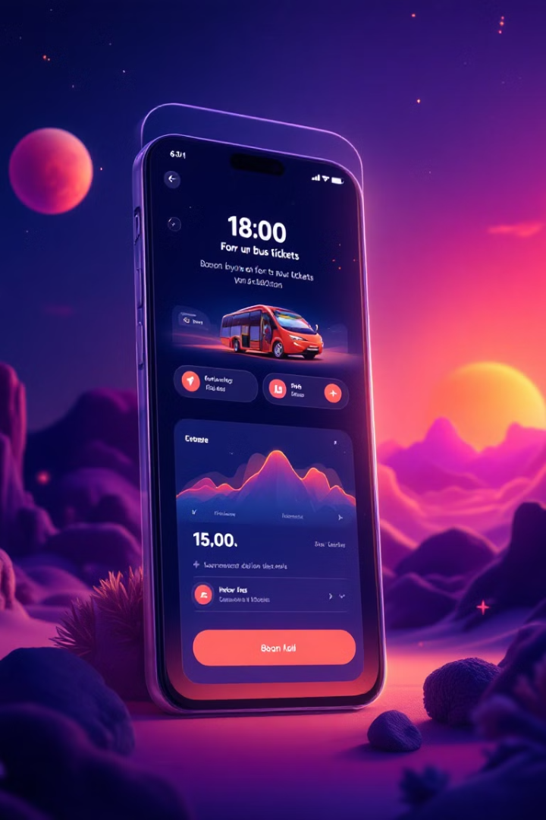

Module 4: Interface
Search and Filter Functionality
The interface provides a user-friendly search and function for travelers to find their desired bus routes based on origin, destination, and Price.

Slide 6

Challenges and Lessons Learned
1
Handling Dynamic Website Changes
The Redbus website frequently updates its structure and content, which posed challenges for the web scraper.
2
Data Consistency and Integrity
Ensuring the accuracy and completeness of the extracted data required meticulous data cleaning and validation procedures.
3
User Interface Design and Usability
Designing an user interface for the travel booking platform was critical for user satisfaction.

Slide 7
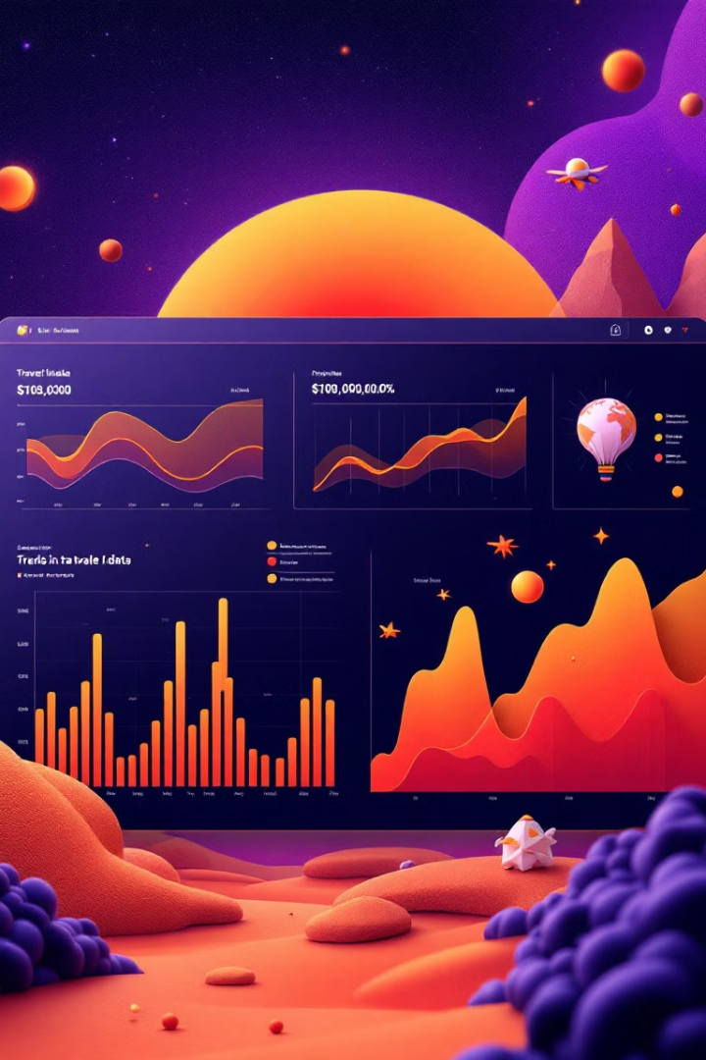


Key Insights and Findings
Popular Bus Routes
The data analysis identified the most popular bus routes and travel destinations based on user searches and bookings.
User Preferences
The analysis shed light on user preferences, such as preferred bus types, rating, and pricing considerations.

Slide 8


Next Steps and Future Improvements
Real-Time Updates
1
The system will be enhanced to provide real-time updates on bus schedules, availability, and pricing.
Enhanced User Experience
2
The user experience will be further improved by implementing features such as online ticketing, seat selection, and customer support.

